Slide 1

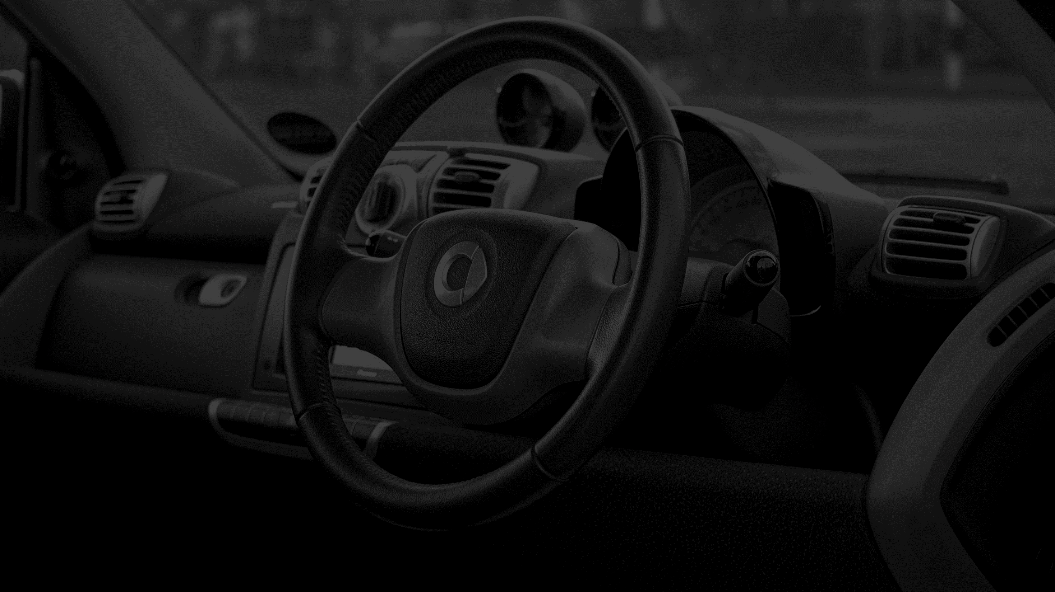
OverSee: an AI based driver state monitoring system
GOLF-A

Slide 2
Team Members
201814030 Tasnia Iqbal
201814054 Tasneem Mubashshira
201814060 Ifath Ara
201814061 Fariha Fardina Amin

Slide 3
Objective of our project
Making a Dedicated device for monitoring the driver while driving
01
Alarming the driver as well as the passenger to avoid accidents
02
Giving automatic suggestion for improving driver’s current state
03

Slide 4

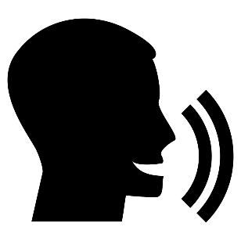


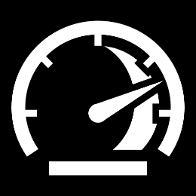
Features
+
Suggesting parking slot coffee shop
Drowsiness Detection
Anger/Stress Detection
Inattention Detection
Speed Detection

Slide 5
Work Done
Project proposal
Project Scheduling
Requirement discovery
Requirement specification
System Architecture
Sequence and use case diagram
Activity diagram
UI Design

Slide 6
Hardware Equipment
Microcontroller (raspberry pi / jetson nano)
Pi Camera
Display
Sound Box
GPS sensor
IMU sensor (accelerometer)

Slide 7
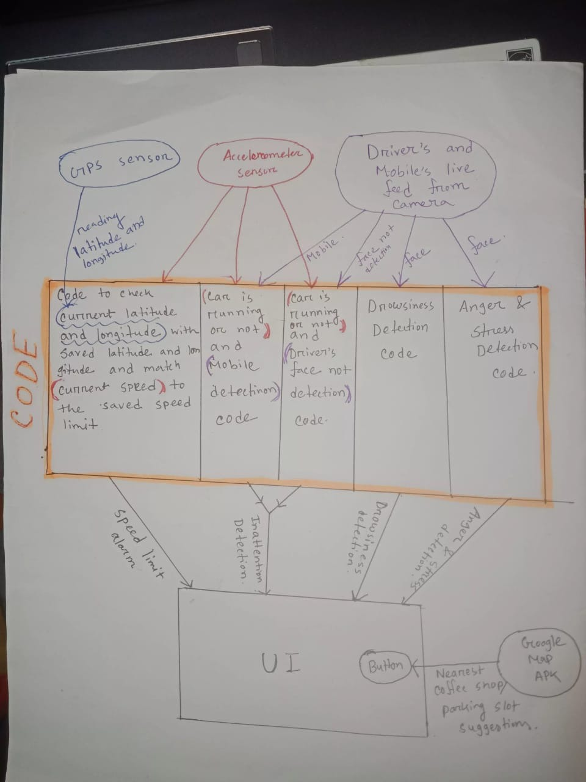

Slide 8
Challenges
Deep learning Model Implementation
GPS / Google Map
Integrate All in Display
Hardware

Slide 9
Work Distribution
Backend(Drowsiness, Stress, Inattention and code merging with sensor values) – Tasneem Mubashshira and Ifath Ara
GPS and Accelerometer sensor reading(Speed Detection) – Tasnia Iqbal
Display and Front End – Fariha Fardina Amin

Slide 10
Any Query ???

